Slide 1



Solar magnetic fields:
diagnostics and applications
^{A. Asensio Ramos}
Instituto de Astrofísica de Canarias
aasensio.github.io/blog
@aasensior
github.com/aasensio

Slide 2
Solar magnetic fields:
diagnostics and applications
Lecture 1
Stokes profiles in different structures
Physical intuition from profiles
Atomic parameters
Zeeman vs. Paschen-Back
Azimuth disambiguation
Stray-light
Web+python useful tools
Noise – denoising
NLTE & Hanle effect

Slide 3
Inference

Slide 4
github.com/aasensio/SolarnetGranada

Slide 5
git clone https://github.com/aasensio/SolarnetGranada

Slide 6
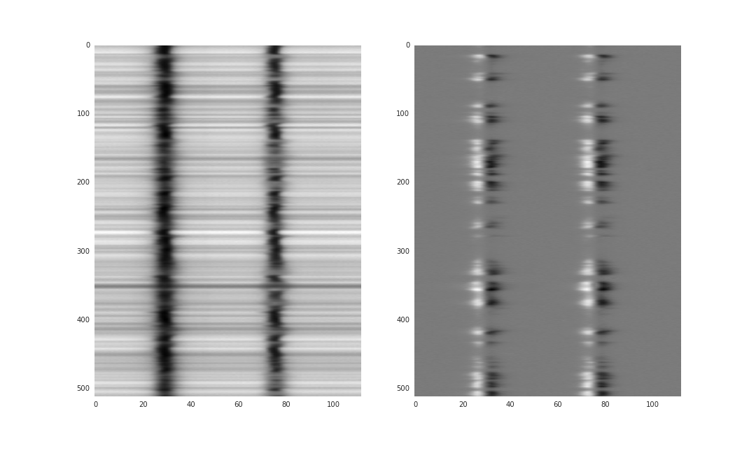
The data
Interesting…. and now, what?

Slide 7
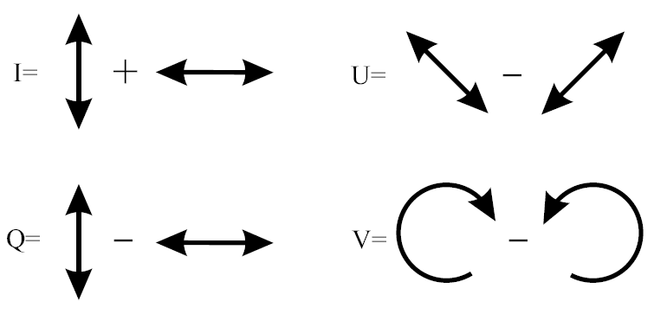
Operative definition of Stokes parameters

Slide 8
Symmetry breaking produces polarization
All physical effects that produce polarization
are related to a symmetry breaking effect
Zeeman effect → deterministic magnetic field
Scattering polarization → non-symmetric scattering
Hanle effect → scattering+magnetic field
Faraday rotation → deterministic magnetic field

Slide 9
Physical intuition
One should be able to qualitatively understand 90% of the profiles in a map without resorting to any modeling
What can we infer from a quick look?
Estimation of field strength
Estimation of filling factors
Physical effect at play
Presence of gradients along the line of sight
Examples

Slide 10

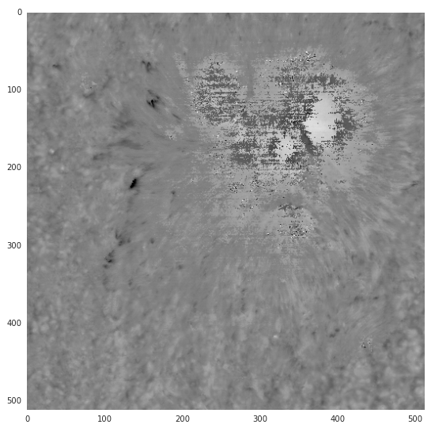

Visualization (zero-order) calculations
Contrast
Doppler velocities

Slide 11

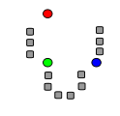
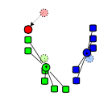
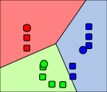
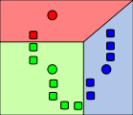
Physical intuition - Classification
Sometimes, a visual inspection is not enough to detect all possibles profiles
In this case, unsupervised classification (or clustering) is usually a good idea to make a qualitative analysis
For instance, k-means is a good option

Slide 12
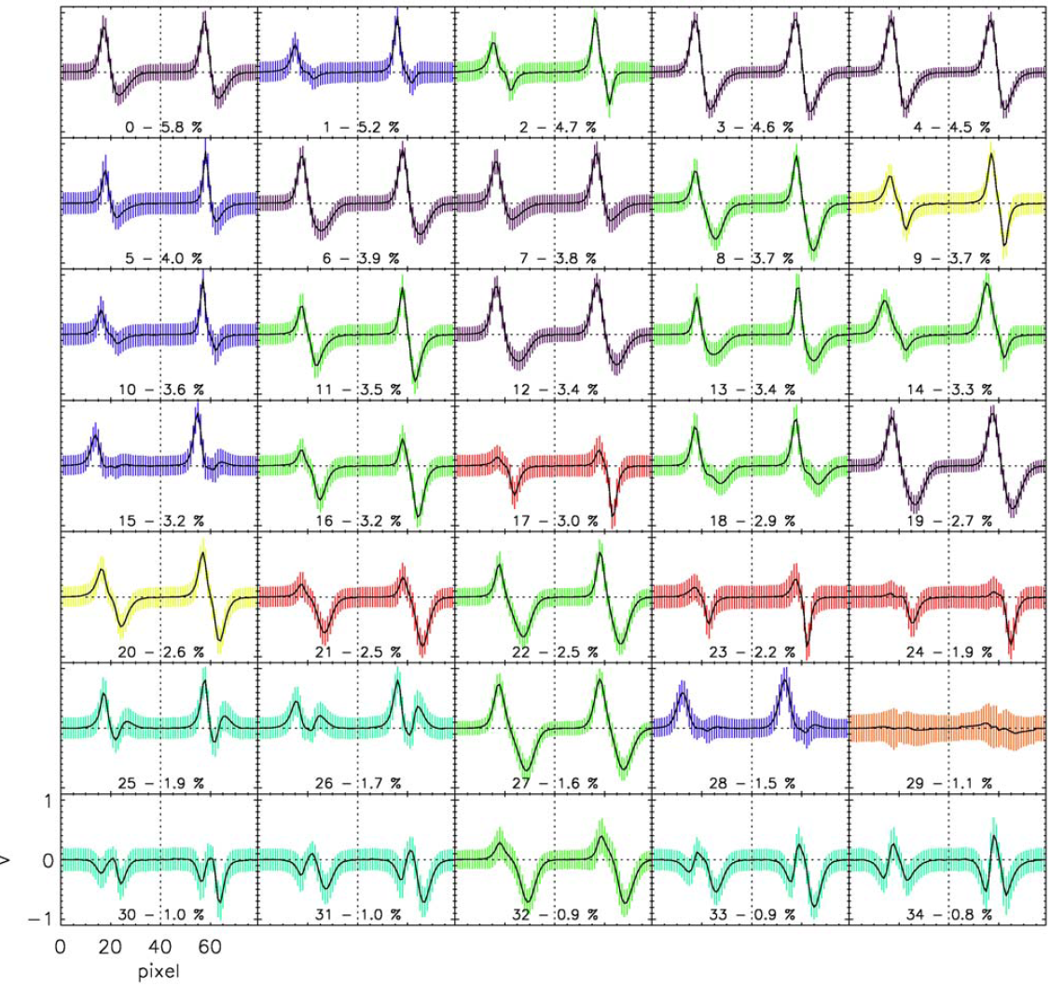
Physical intuition - Classification
Viticchié & Sánchez Almeida (2011)

Slide 13
Useful web tools
Milne-Eddington simulator
Local thermodynamical equilibrium
Hanle effect

Slide 14
Useful Python/IDL tools
Milne-Eddington synthesis
Local thermodynamical equilibrium
Hanle effect

Slide 15
Atomic parameters
Astrophysics is a science fundamentally based on inductive reasoning
We make many observations, discern a pattern, make a generalization
and infer an explanation or a theory from it
Observational spectropolarimetry uses a mixture of quantum mechanics
and radiative transfer theory to infer the properties of remote plasmas
We need to fix the details of the quantum mechanics to infer the
thermodynamical and magnetic properties of the plasmas

Slide 16
Atomic parameters
One of the things we need to fix are the atomic parameters, that we need
to get from other sources (laboratory experiments, ab-initio calculations, …)
Einstein coefficients (oscillator strengths)
Landé factors
Level energies
Collisional rates

Slide 17
Atomic parameters - Resources
NIST spectroscopy database http://www.nist.gov/pml/data/asd.cfm
Kurucz database http://www.pmp.uni-hannover.de/cgi-bin/ssi/test/kurucz/sekur.html
CHIANTI database http://www.chiantidatabase.org/
VAL-D database http://vald.astro.uu.se/
Other databases http://www.pa.uky.edu/~verner/lines.html
ADS in individual papers

Slide 18
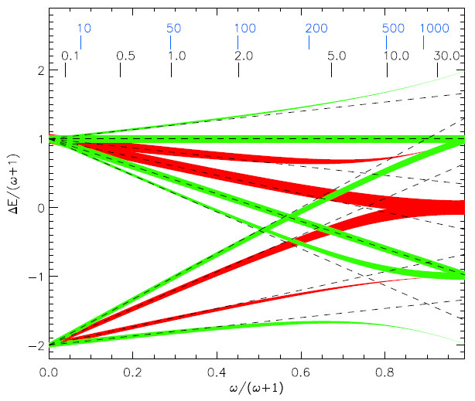
Zeeman vs. Paschen-Back
Kochukhov (2008)

Slide 19
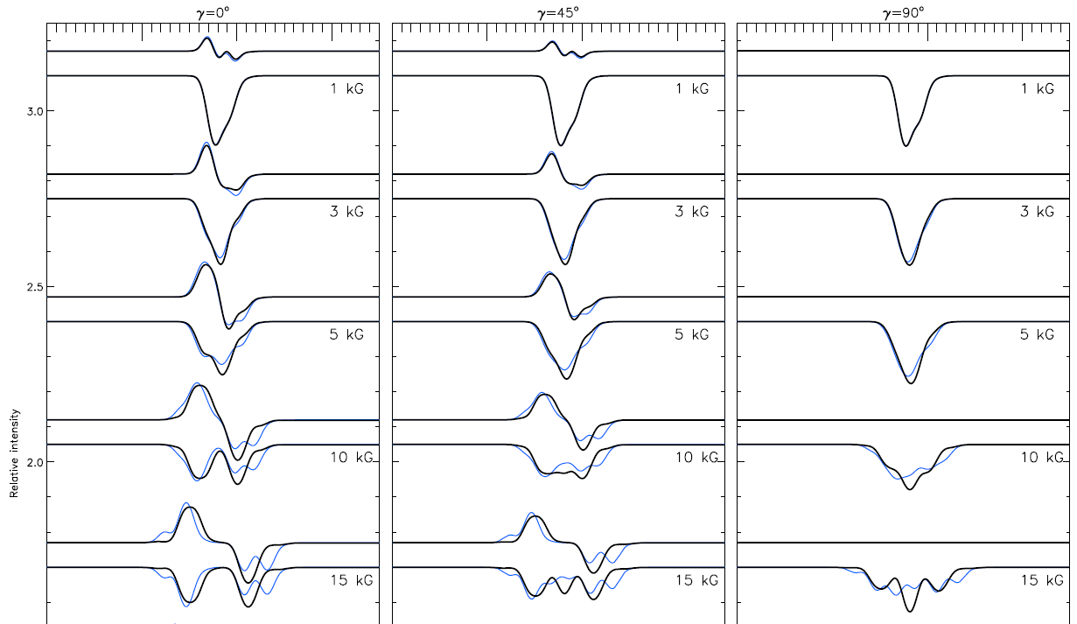
Zeeman vs. Paschen-Back
Kochukhov (2008)

Slide 20

Azimuth disambiguation
The radiative transfer equation is invariant to the change
Therefore, two azimuths with respect to the line-of-sight that differ in
180º produce exactly the same Stokes parameters in the Zeeman
regime
This ambiguity cannot be, in general, resolved spectroscopically, but
2D information has to be taken into account → it is a combinatorial
problem

Slide 21
Azimuth disambiguation – techniques
By hand (Lites)
Choose between the two possibilities by hand
Potential-field acute-angle
Using FFTs (K. Leka, J. Jing) with/without flux balance, boundary padding
Based on Green's Function solution (J. Li, V. Yurchyshyn)
Large-Scale Potential method (A. Pevtsov)
assumes large-scale fields are potential, deviations increase with spatial resolution
Linear Force-Free Acute-Angle method (H.N. Wang)
Best-fit to LFFF field consistent with coronal-loop observations
Uniform Shear Method (Y.J. Moon)
assumes shear angle follows a normal distribution
Magnetic Pressure Gradient (J. Li)
assumes magnetic pressure decreases with height
Minimum Structure (M. Georgoulis)
Minimize a component of current analytically, then numerical smoothing
Non-potential Magnetic Field Calculation (M. Georgoulis)
Finds the distribution of Bz whose potential extrapolation plus a calculated non-potential component best matches the observed heliographic field.
Pseudo-Current Method (A. Gary)
Minimizes Jz2 by locating sources of non-potentiality
U. Hawaii Iterative Method (Metcalf, Fan & Leka)
Iterates locally to minimizes Jz and div(B), then acute-angle neighbor smooths
Minimum-Energy solution (Metcalf)
Global optimization of J and div(B), numerous weighting options

Slide 22
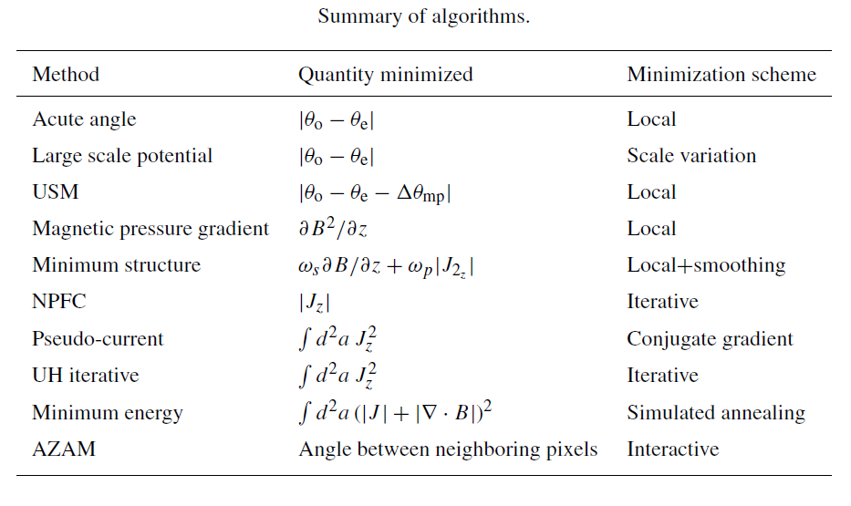
Azimuth disambiguation – merit function
Metcalf et al. (2006)

Slide 23
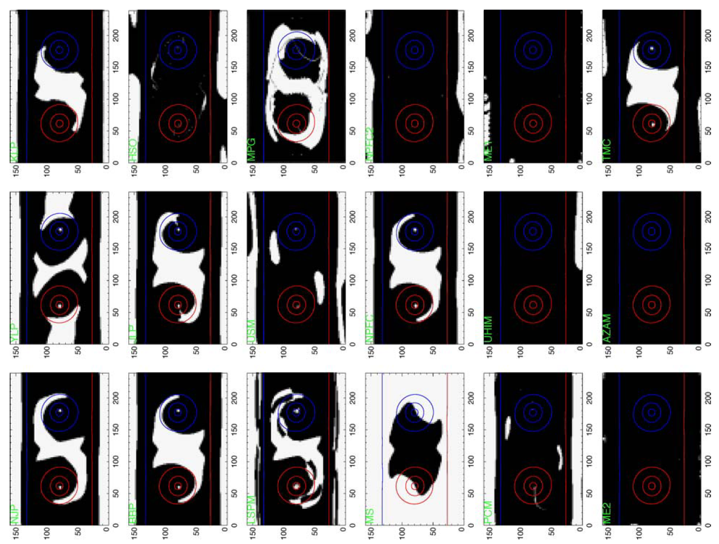
Azimuth disambiguation – merit function
Metcalf et al. (2006)

Slide 24
Stray-light
The light observed in a given pixel with a telescope is not exclusively
coming from the solid angle associated to the pixel
The telescope PSF and any unwanted reflection in the telescope
is responsible of this behavior
Stray-light is usually dealed with by using an additive component
but this is not correct → deconvolution with PSF

Slide 25
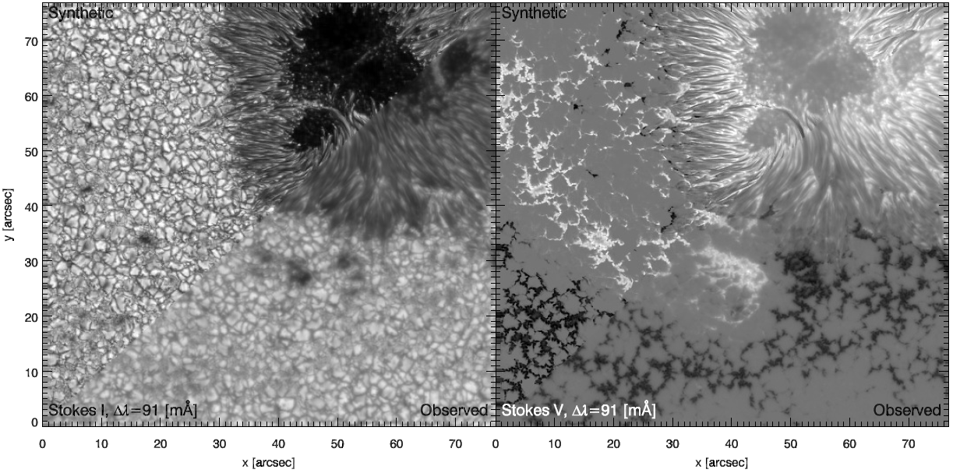
Stray-light - deconvolution
The stray-light produces a significant decrease in the contrast

Slide 26
Noise and systematics
Observed data is always made of different sources
Real signal
Noise
Multiplicative noise (photon noise)
Additive noise
Systematics
Fringes
…
All of them will affect the inference we make from the Stokes profiles
We have to deal with them before (or ideally, during) the inference

Slide 27
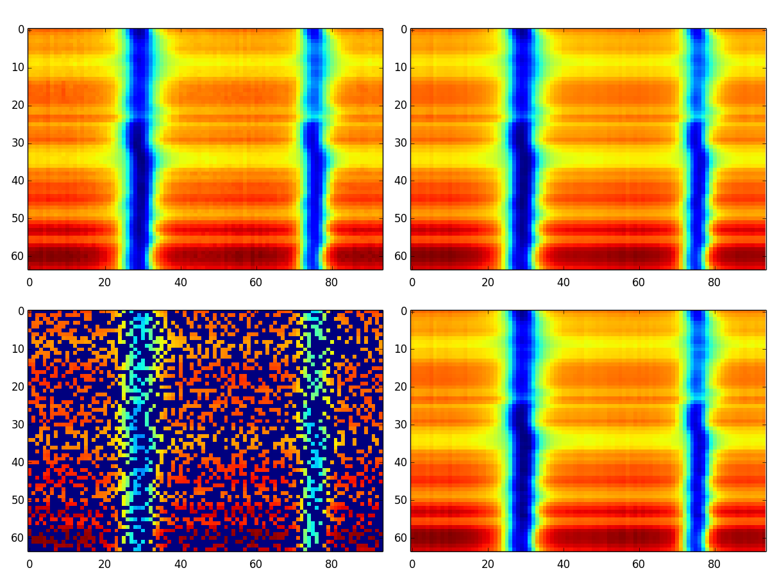
Denoising
Filter noise with low-pass filters
Wavelet denoising
Low-rank assumption
See the observations as a collection of N_{λ}-dimensional vectors
forming a matrix

Slide 28

Denoising – Principal component analysis
We see that all rows are very similar, with small differences
We expect that not all rows are linearly independent → the matrix has low rank
Left singular vectors
Right singular vectors
Singular values
Signal is low-rank
Noise is high-rank
Low-rank approximation extracts
mainly the important signals

Slide 29
Denoising
Filter noise with low-pass filters
Wavelet denoising
Low-rank assumption

Slide 30
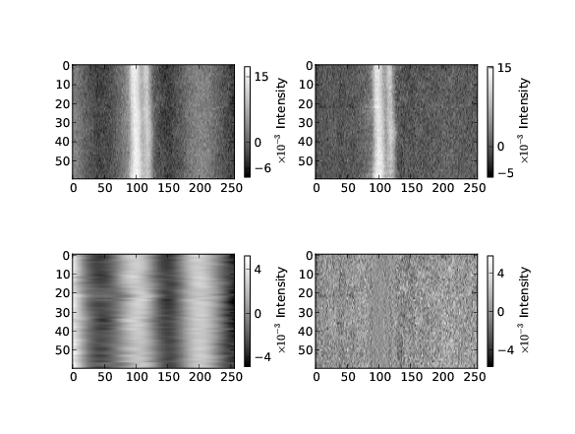
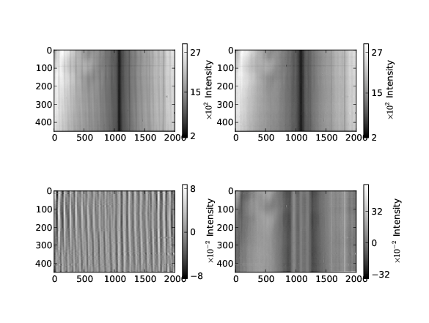
Defringing
Fringes manifest as quasi-periodic signals in the data

Slide 31
Defringing
Fringes manifest as quasi-periodic signals in the data
Fit periodic signals and substract – do it by hand
Fourier transform the spectrum, remove the frequencies and return to the real space – again, by hand
Use principal component analysis and hope that fringes appear in isolated singular vectors – based on luck
Machine learning: mainly unexplored
relevance vector machines – quite automatic
morphological component analysis – unexplored

Slide 32
Defringing - RVM

Slide 33
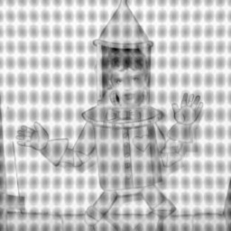
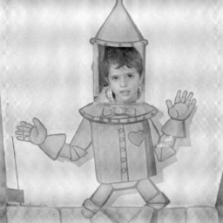
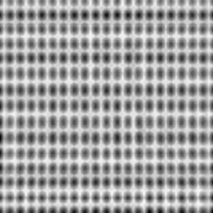
Defringing - MCA
Bobin et al. (2007)

Slide 34
Lines in non-local thermodynamical equilibrium
(some ideas to understand afternoon classes)

Slide 35
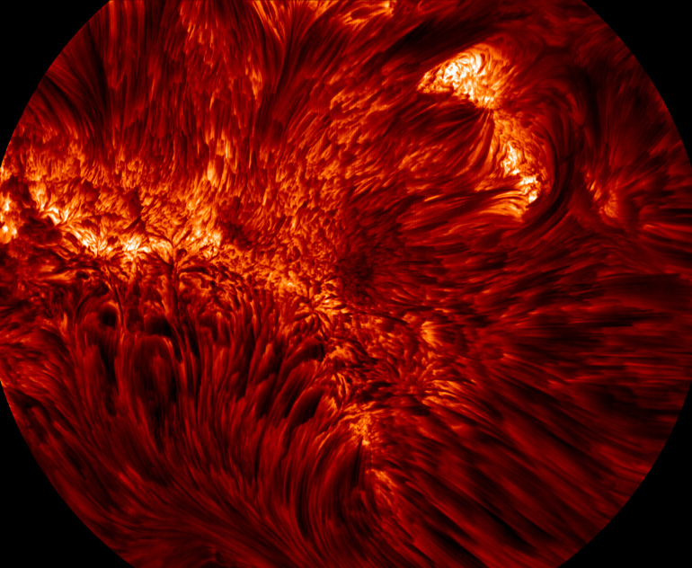
Strong lines – Hα - NLTE
NST

Slide 36
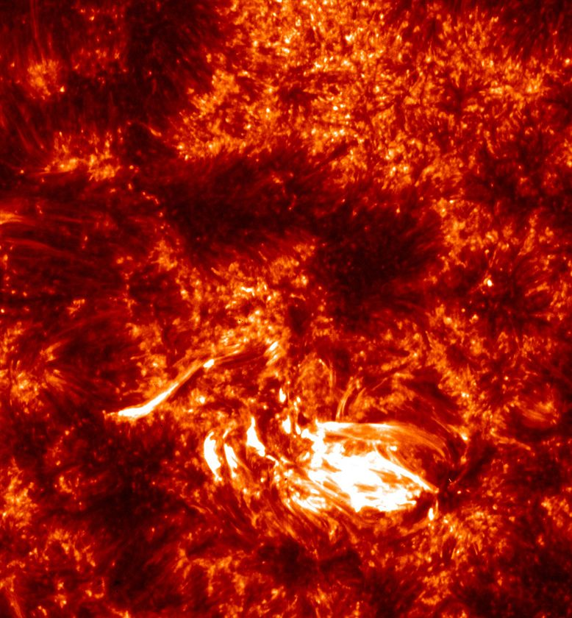
Strong lines – Mg II h&k - NLTE
IRIS

Slide 37
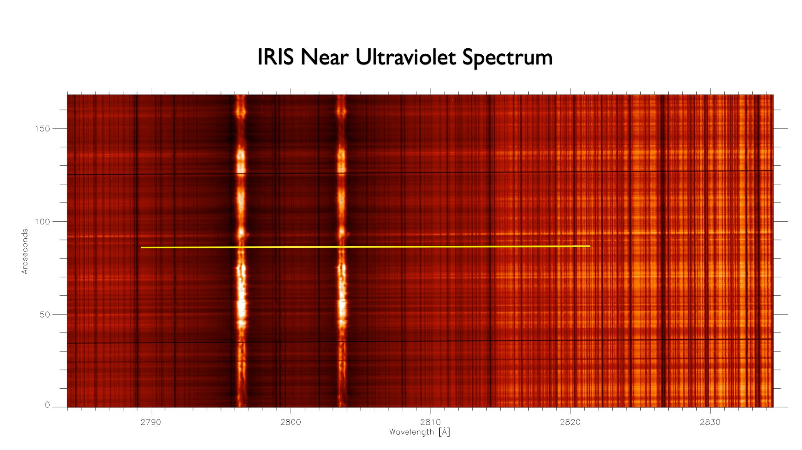
Strong lines – Mg II h&k - NLTE
IRIS

Slide 38
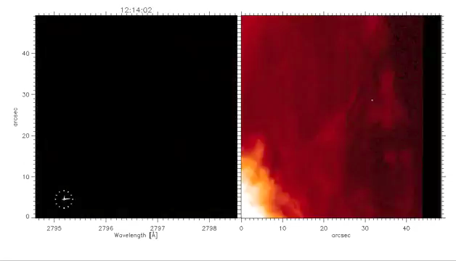
Strong lines – Mg II h&k - NLTE
IRIS – Mg II h

Slide 39
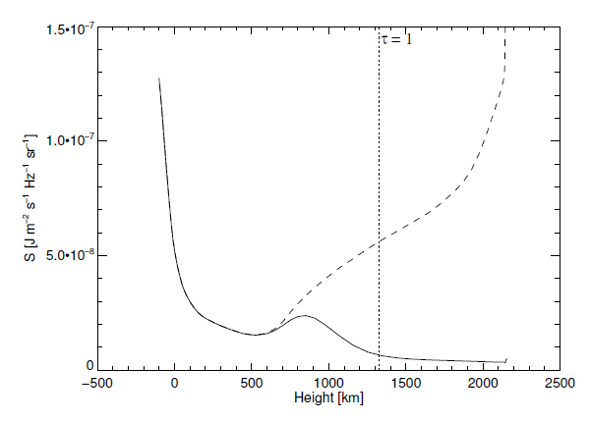
Strong lines –NLTE
Strong lines are usually not in local thermodynamical equilibrium
The source function is not directly dependent on the local temperature
The excitation state of the atomic levels depend on the non-local radiation field at each point in the atmosphere
Ca II 8542 A
Uitenbroek (2006)

Slide 40
LTE - Solution
Level population
(known)
Radiative transfer equation

Slide 41
NLTE - Solution
Statistical
equilibrium
equations
Radiative transfer equation
Radiation field
Level population

Slide 42
Strong lines –NLTE
n_{k}
n_{j}
n_{i}
We are interested in the populations of the atomic/molecular levels
which are consistent with the radiation field present in the plasma
Non-local and non-linear problem

Slide 43



NLTE - Equations
Statistical equilibrium
equations
Radiative transfer
equation
Mean intensity

Slide 44
Scattering polarization and Hanle effect
(some ideas to understand afternoon classes)

Slide 45
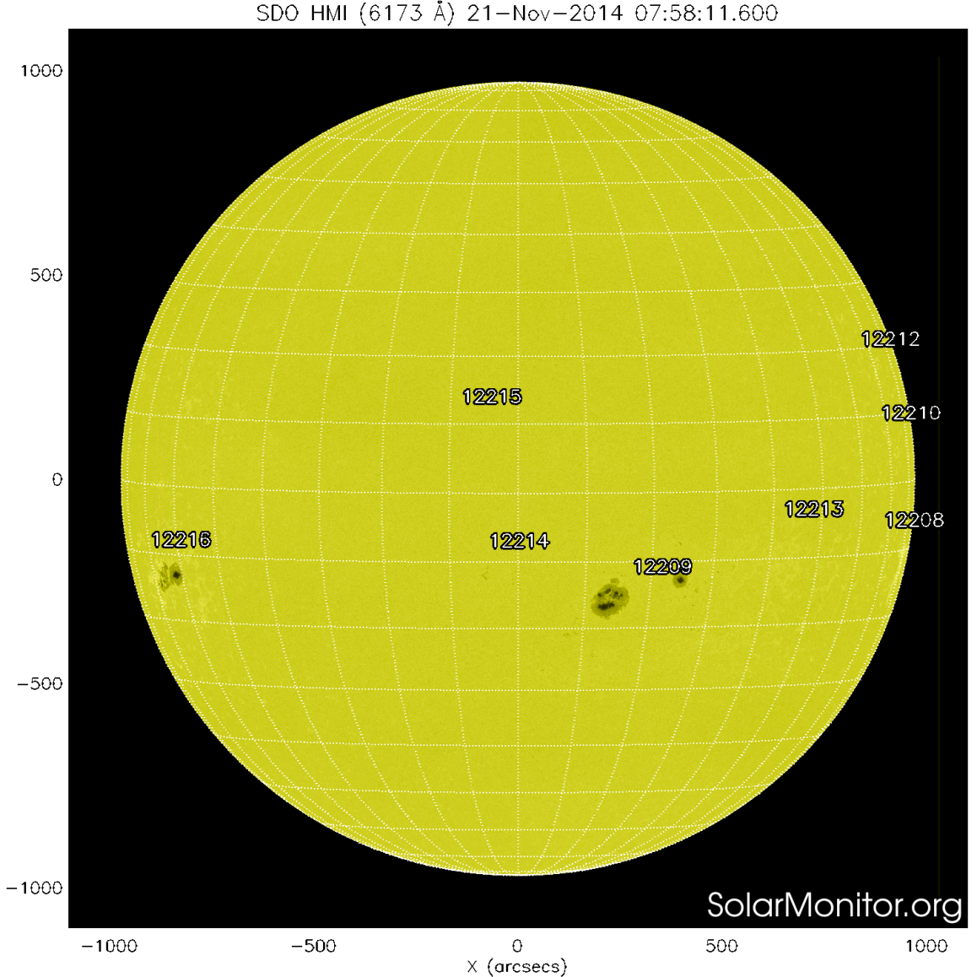
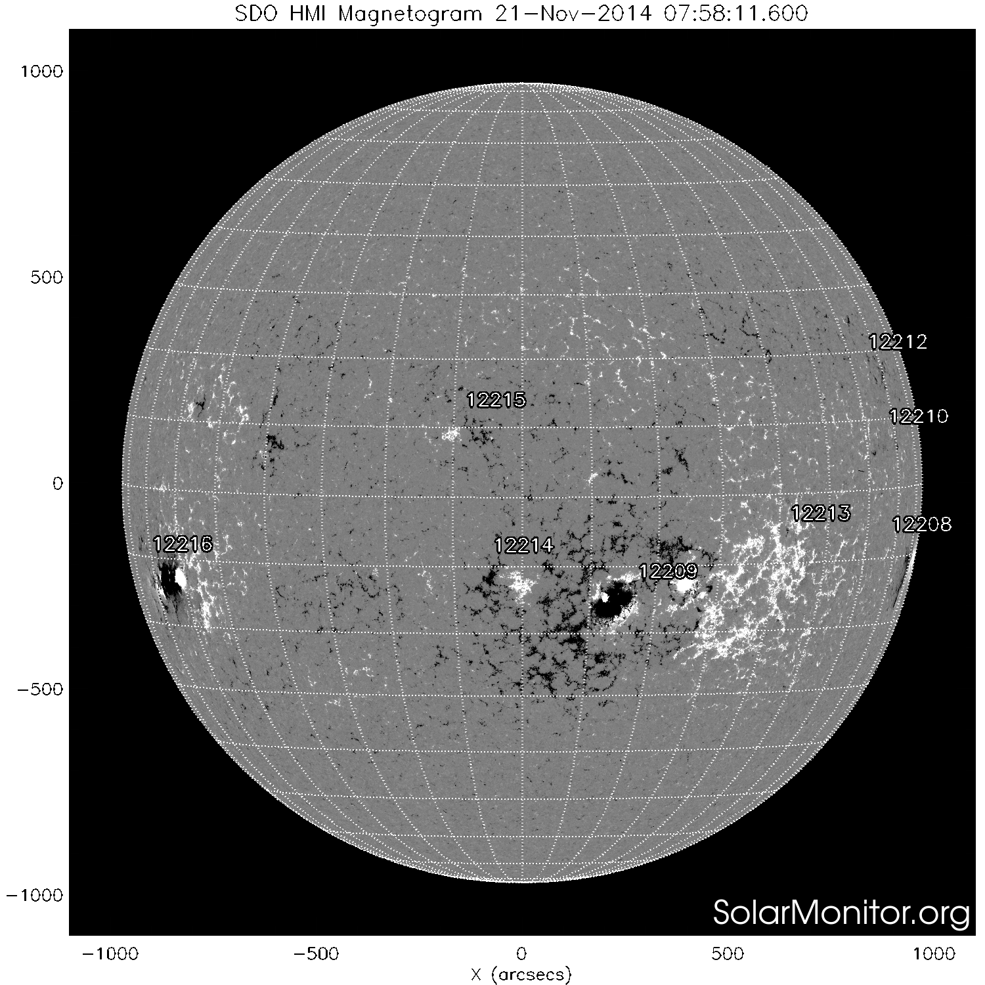
Polarization in spectral lines
Zeeman effect. Circularly polarized
light: magnetogram
Line-of-sight projection of B
Black/white: opposite polarities
Visible continuum
(solar surface)

Slide 46
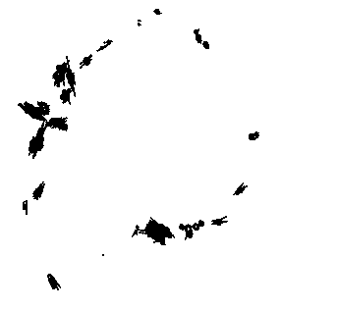
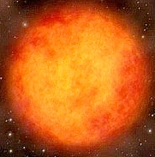
Scattering polarization in spectral lines
Scattering polarization
SiO maser
Typically tangential, but some
are radial because of local
variations of the anisotropy or
the presence of a magnetic
field

Slide 47
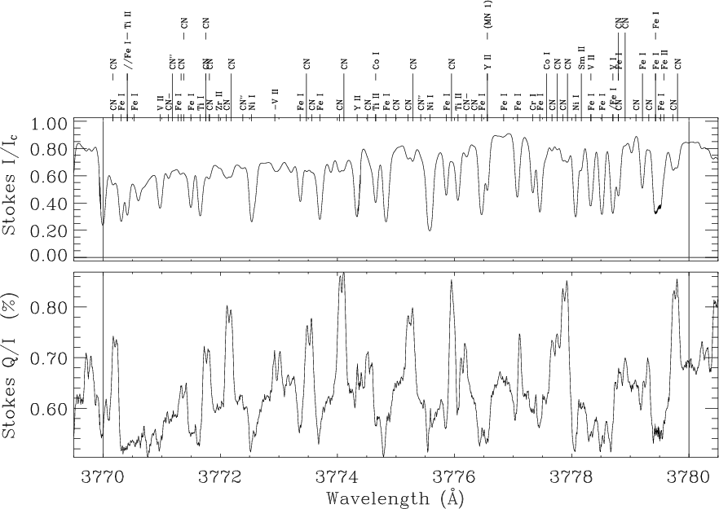
Scattering polarization in spectral lines
The second solar spectrum

Slide 48
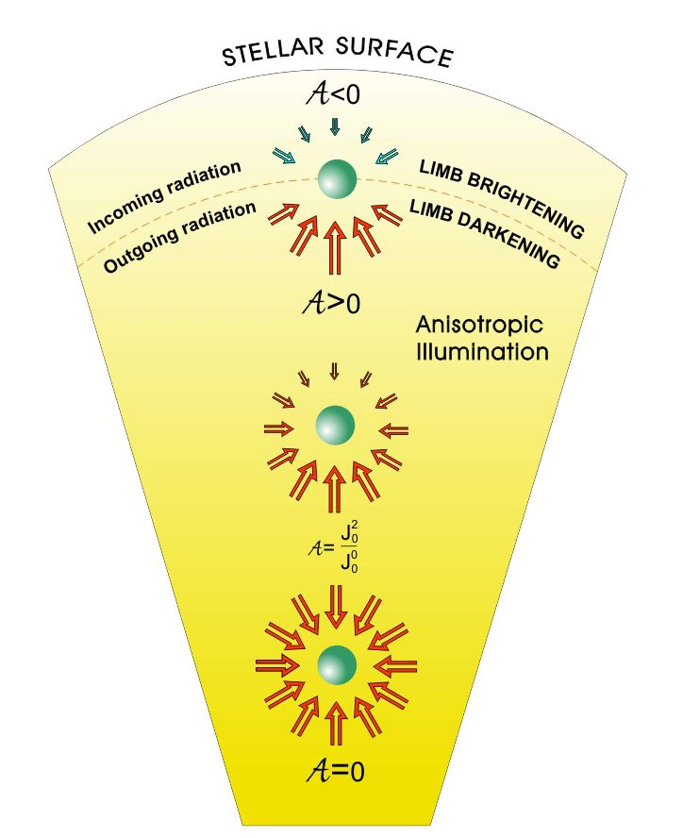
The main ingredient

